Slide 1
THE FRENCH MARINE, AVIATION & TRANSPORT INSURANCE MARKET MEETS THE GREEK SHIPOWNERS
Athens 19/09/2017

Slide 2
THE FRENCH MARINE, AVIATION & TRANSPORT INSURANCE MARKET MEETS THE GREEK SHIPOWNERS
Cyrille DUPONT
President
French-Hellenic Chamber of Commerce and Industry
Athens 19/09/2017

Slide 3
THE FRENCH MARINE, AVIATION & TRANSPORT INSURANCE MARKET MEETS THE GREEK SHIPOWNERS
Panagiotis KOUROUMBLIS
Minister of Shipping and Island Policy
Athens 19/09/2017

Slide 4
THE FRENCH MARINE, AVIATION & TRANSPORT INSURANCE MARKET MEETS THE GREEK SHIPOWNERS
THE PARISMAT INITIATIVE / THE TOP QUALITY FRENCH MARKET CAPACITY
Mathieu BERRURIER
Chairman of UCAMAT & Chairman of Groupe Eyssautier
&
Henry ALLARD
Vice Chairman of UCAMAT & Chairman of Filhet Allard Maritime
Moderator: Ilias BISSIAS, Naftika Chronika
Athens 19/09/2017

Slide 5
THE FRENCH MARINE, AVIATION & TRANSPORT INSURANCE MARKET MEETS THE GREEK SHIPOWNERS
THE PARISMAT INITIATIVE
Mathieu BERRURIER
Chairman of UCAMAT & Chairman of Groupe Eyssautier
Athens 19/09/2017

Slide 6
WELCOME TO FIRST EVENT
Athens 19/09/2017

Slide 7
ENDURING FRANCO-HELLENIC RELATIONSHIP
Greece: the World’s first shipping nation
More than 40 years of strong relationships between Greek shipowners and the French Marine and Transport Insurance Market
Evolution of the French Market
Athens 19/09/2017

Slide 8
THE PARISMAT FOUDING IDEA AND OBJECTIVES
Created in 2016 and officially launched in May 2017 at Les Rendez-vous de l’Assurance Transport (Transport Insurance Meeting)
Aimed at promoting and giving a new dynamic to the French Market
Dedicated to preserving the continuity of the French Market philosophy
Relying on team work to achieve together the same objectives:
INCREASE THE ATTRACTION OF THE FRENCH MARKET
Athens 19/09/2017

Slide 9
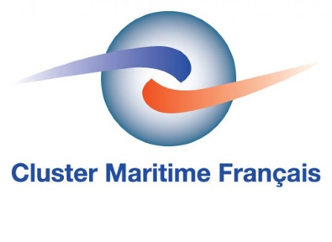
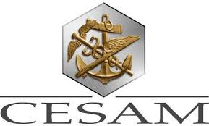
Athens 19/09/2017

Slide 10
THE FRENCH MARINE, AVIATION & TRANSPORT INSURANCE MARKET MEETS THE GREEK SHIPOWNERS
THE FRENCH MARKET’S ASSETS
Henry ALLARD
Vice Chairman of UCAMAT & Chairman of Filhet Allard Maritime
Athens 19/9/2017

Slide 11
A/ MARKET ASSESSMENT
Active Underwriters
Strong financial security
Underwriters speak « Shipowners’ language »
A risk taking approach
Loss prevention minded insurers
Market solidarity
Significant underwriting capacity avalilable
Sustainable market
Athens 19/9/2017

Slide 12
B/ MARKET OUTLOOK
Are we coming to an end of the soft hull market ?
Brexit and the EU
C/ CONCLUSION
French Conditions
Claims servicing
********
Athens 19/9/2017

Slide 13
THE FRENCH MARINE, AVIATION & TRANSPORT INSURANCE MARKET MEETS THE GREEK SHIPOWNERS
NEW FRENCH HULL CLAUSES
Béatrice WITVOET
Partner LBEW
Athens 19/9/2017

Slide 14
THE FRENCH STANDARD HULL CLAUSES
HULL MACHINERY CLAUSE
+ Additional Clauses :
FPA unless
FPA Absolutely
Actual loss and construction total loss
Wreck removal
Contributory value
Lay-up return
Cyber attack exclusion
Increased value and excess liability
Freight interest clause
(2) WAR AND RELATED RISKS CLAUSE:
+ Additional Clauses :
Increased value and excess liability
Extension to third-party liabilities
Freight interest
(3) LOSS OF INCOME CLAUSE:
+ Extension Clauses :
Absence of physical damage
War risks
Athens 19/9/2017

Slide 15
THE FRENCH MARINE, AVIATION & TRANSPORT INSURANCE MARKET MEETS THE GREEK SHIPOWNERS
PARISMAT INITATIVE /
FRENCH MARKET CLAIMS PHILOSOPHY AND PRACTICES
Régis BROUDIN
Regional Head of Marine Claims, Allianz Global Corporate & Specialty SE
Athens 19/9/2017

Slide 16
CLAIMS PHILOSOPHY
Dedicated claims teams
Proactive approach
Open dialogue ship with the broker and the ship owners
Solutions oriented
Cost control
Athens 19/9/2017

Slide 17
CLAIMS TECHNICAL SKILLS
French University providing recognized maritime law degrees (Brest, Nantes, Marseille, Lille, Le Havre, Paris….)
Claims handlers with maritime law background, strong experience and know-how.
End to end claims handling including emergency management, repair solutions, loss adjustment, negotiation with third parties, recovery action
Claims handling with the support of in-house Marine Engineers
Marine professionals network (lawyers, surveyors, salvors…)
Athens 19/9/2017

Slide 18
RESPONSIVENESS AND PROACTIVITY
Partnership with the broker and the ship owners
We accompany ship owners at each steps of the claim to take decision and to find solutions (minimizing losses, negotiation of salvage/ towage contracts …).
24/7 Claims Service
Emergency management
Prompt delivery of Letter of Undertaking
Rapid settlement
Athens 19/9/2017

Slide 19
COST CONTROL
A shared objective between insurers and brokers
in-house claims handling skills to:
- facilitate amicable negotiations
- avoid protracted and expensive legal proceedings
- reduce external costs
Athens 19/9/2017

Slide 20
STRONG MARKET WITH DEDICATED TOOLS
Financial strength of the insurance companies that secures the settlements of claims and the issuance of Letters of undertaking
Optiflux system : electronic exchange of datas. When a claim payment is validated by the French leader the coinsurers shares are automatically paid
CESAM International network of Average Agents and surveyors
Athens 19/9/2017

Slide 21
THANK YOU FOR YOUR ATTENTION
Athens 19/9/2017

Slide 22
THE FRENCH MARINE, AVIATION & TRANSPORT INSURANCE MARKET MEETS THE GREEK SHIPOWNERS
CESAM – AN ADDED VALUE
Patrice GILBERT
CEO of CESAM
Athens 19/09/2017

Slide 23
CESAM is a structure of which Marine Insurers operating in France are members.
Based in Paris, its missions are:
Make available a worldwide network of Average agents for the members and their clients
Provide advices and follow the claims in case of major event.
Organize the “Rendez-vous de l’Assurance transports” each year in Paris. The first time for this international event was on 28th-29th April 2009 on the theme of “Giantism viz insurance”.
Manage the financial flows in case of coinsurance. And, now, operate the Optiflux© system.
Athens 19/09/2017

Slide 25
OPTIFLUX©
A secure system for electronic data
transfer in the French Marine Insurance Market
Athens 19/09/2017

Slide 27
THE FRENCH MARINE, AVIATION & TRANSPORT INSURANCE MARKET MEETS THE GREEK SHIPOWNERS
THE PRESENTATION OF THE FRENCH MARITIME CLUSTER
Frédéric MONCANY DE SAINT-AIGNAN
Chairman of the French Maritime Cluster
Athens 19/09/2017

Slide 28
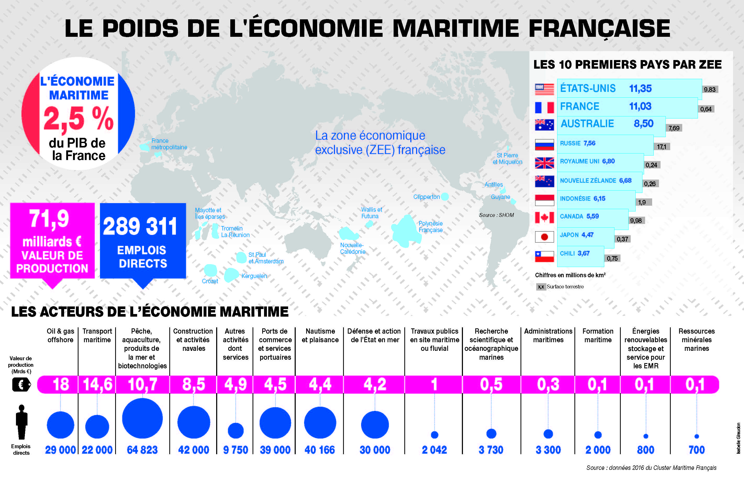
Athens 19/9/2017

Slide 29
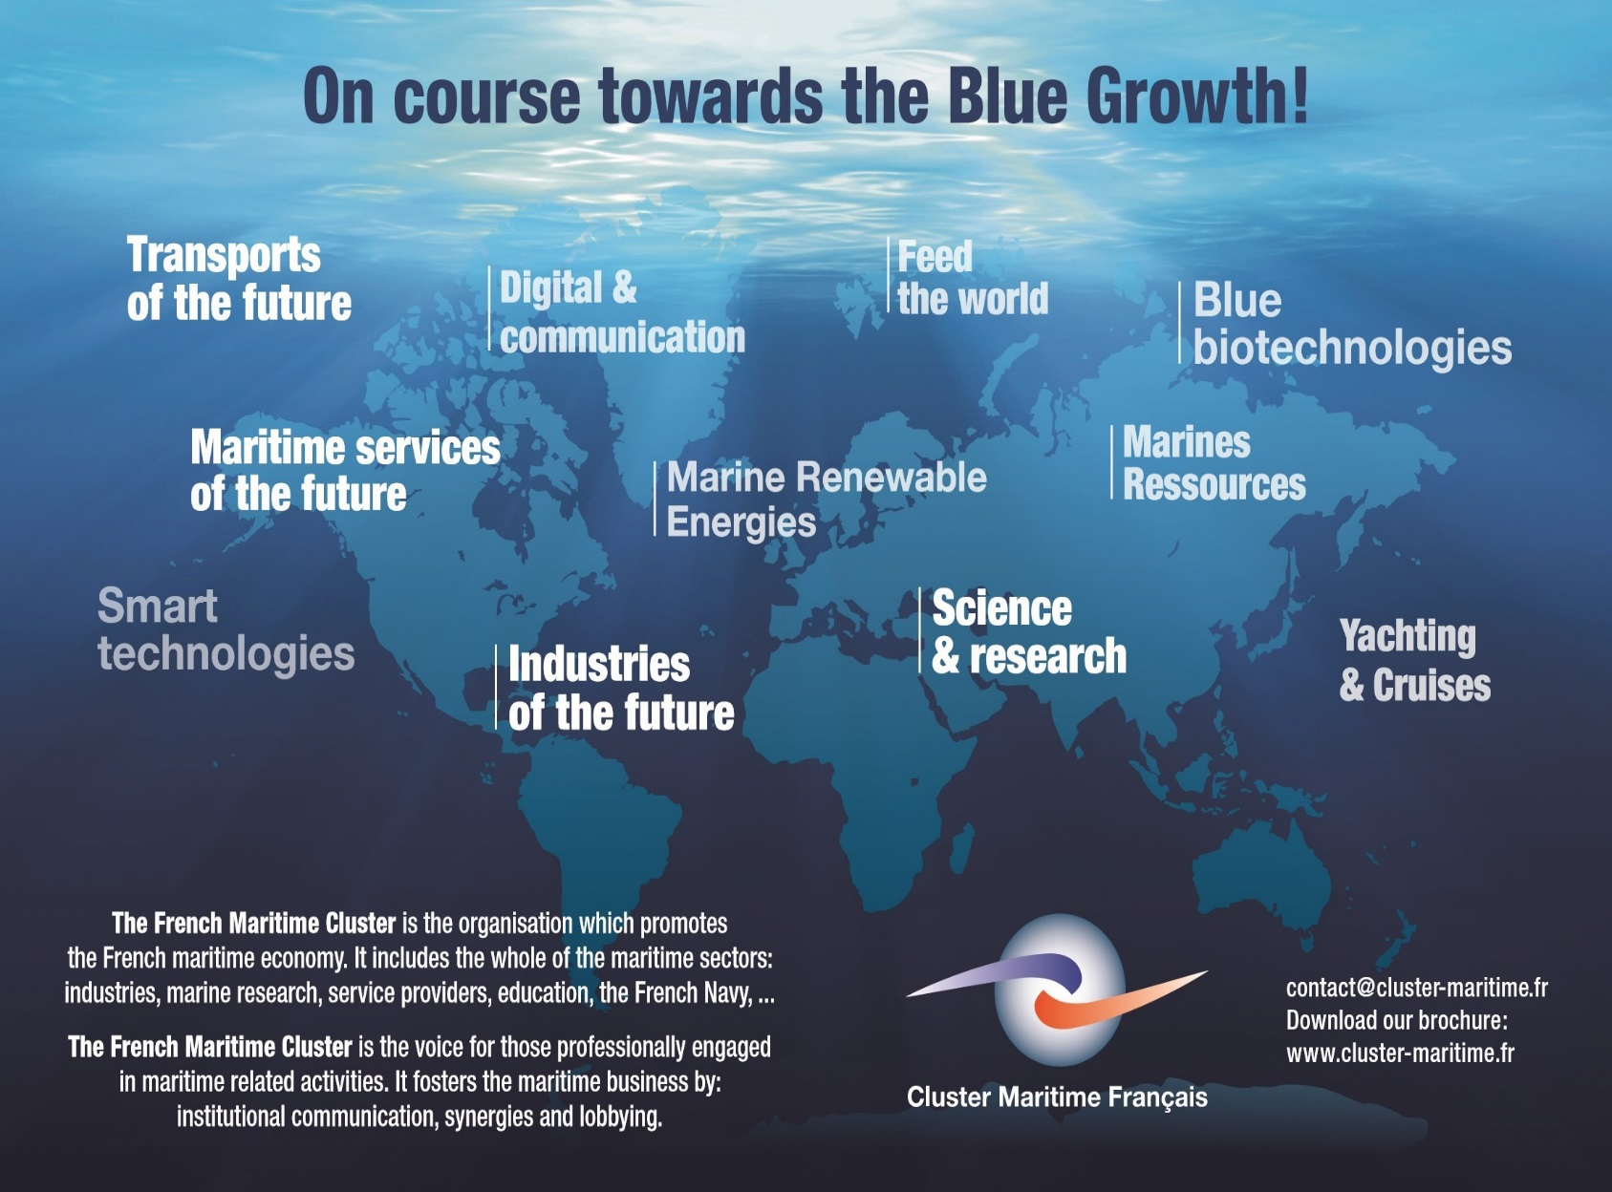
Athens 19/9/2017

Slide 30
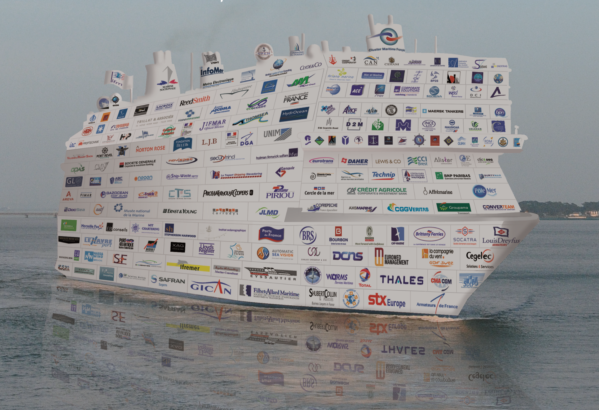
Athens 19/9/2017

Slide 31
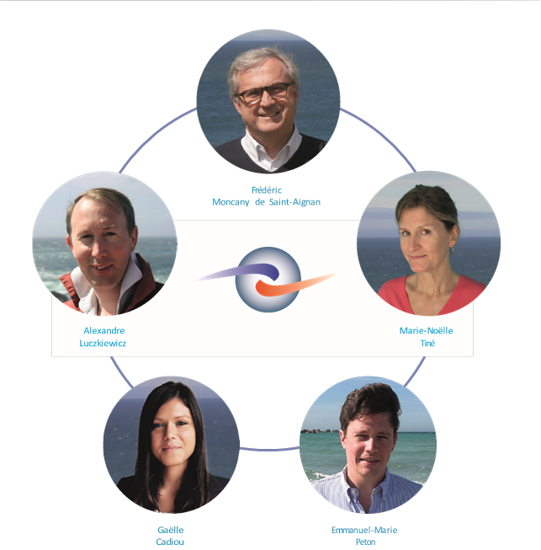
Athens 19/9/2017

Slide 32
THE FRENCH MARINE, AVIATION & TRANSPORT INSURANCE MARKET MEETS THE GREEK SHIPOWNERS
Athens 19/09/2017

Slide 33
THE FRENCH MARINE, AVIATION & TRANSPORT INSURANCE MARKET MEETS THE GREEK SHIPOWNERS
THE FRENCH MARKET FROM THW GREEK SHIPOWNERS’PERSPECTIVE: THEIR VIEWS AND EXPECTATIONS
Christos G. ANAGNOSTOU
Director, Starbulk Management Inc.
Nicolas FRANGISTAS
CEO, Franco Compania Naviera S.A.
George PAPADOPOULOS
General Manager, Safe Bulkers Management LTD
Xavier RATABOU
Director, Filhet Allard Maritime
Mireille TIREL
Director, GROUPE EYSSAUTIER – Paris
Nikos VERNIKOS
Président, International Chamber of Commerce
Moderator: Yannis PERLEPES, Naftemporiki

Slide 34
THE FRENCH MARINE, AVIATION & TRANSPORT INSURANCE MARKET MEETS THE GREEK SHIPOWNERS
Athens 19/09/2017

