Slide 1
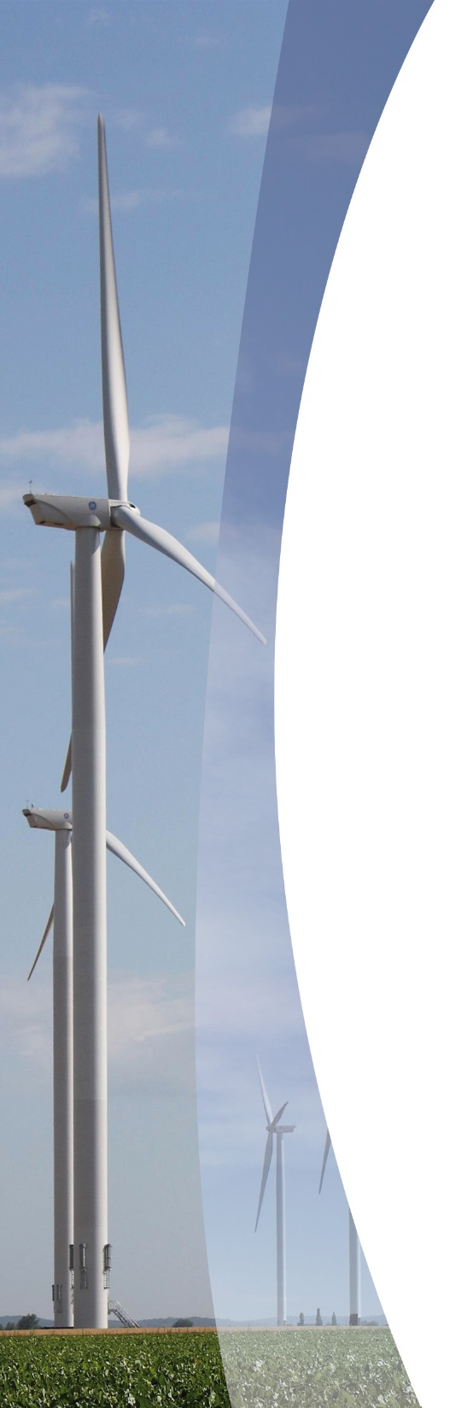
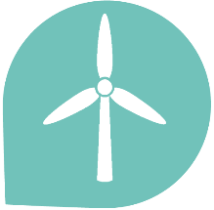
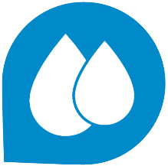
26 years of experience
300 employees
Development
Transport & Construction
O&M
Turnover
M€
2 150 MW
Developing
945 MW
Installed capacity
including 329 MW
Owned by Valorem in operation
1 485 MWc
Developing
121 MWc
Installed capacity
Including 55 MWc Owned by Valorem in operation
25 MW
developing
650 KW
Installed capacity
Including 11 MW Owned by Valorem in operation
Total installed capacity owned by Valorem : 395 MW

Slide 2
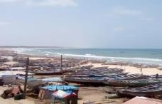
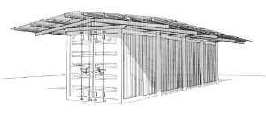
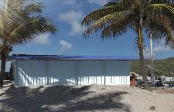
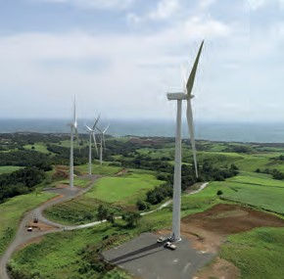
Corporate social and environmental policy
Throughout the project
Innovative solutions
Cryosolar – Senegal and Guadeloupe
A system able to both cool and generate power from 100% renewable sources
Responsible purchasing charter
Employment of local job-seekers
Local economic gains – discount on electricity price for local citizens
Local communication
Crowdfunding-type equity
Fishing boats in Senegal
Insul’Grid – Guadeloupe
This facility increases the production of electricity from renewable sources in Guadeloupe by 10%, thus reducing its dependence on fossil fuels.
Photomontage of the container in Guadeloupe
Wind farm
Distribution into electrical grid
EMS
Smart energy management system
Electrical delivery station
Lithium-ion battery
16 MW wind farm
5,5 MW storage system
Commissioning in 2018
33 GWh/year

Slide 3
VALOREM is increasing its presence on the international scene. After the development of its activities in the northern part of Europe, VALOREM decided to explore the southern european markets
Why Greece ?
Greece benefits from strong fundamentals in terms of:
Regional positionning : member of the EU
Committments to the Green new deal
Renewable energy potential
Know-how in the renewable energy market
Regulatory stability
Economical and financial robustness

Slide 4
VALOREM in Greece:
REN VALOREM HELLAS created in 2019 with two employees
A portfolio of 82 MW of wind and 150 MW of PV projects
Partnership with local companies
Long-term commitment

