Slide 1
Edenred
Marilena Soulogianni
HR Director - Edenred Greece
Regional CSR – Edenred SEMEA

Slide 2
Edenred joins the Euronext CAC 40 ESG® index
Edenred, the world leader in earmarked funds solutions, on September 19, 2022, joined the Paris stock exchange’s Euronext CAC 40 ESG index, taking its place alongside other companies demonstrating outstanding environmental, social and governance (ESG) practices.
Based on an independent assessment by Moody’s ESG Solutions, this event is a recognition of the Group’s commitment to sustainable development. This commitment is embodied in its ambitious “Ideal” ESG policy, its portfolio of digital solutions enabling more responsible behaviors and its purpose, “Enrich connections. For good.”

Slide 3
Engaged in the community
Partner merchants
Public authorities
Edenred has contributed to social progress through its products, which are designed to make life easier for employees and citizens;
By inventing the Ticket Restaurant voucher in the 1960s, Edenred contributed to the democratization of employees’ lunch break;
It was therefore natural for Edenred to become committed to a social responsibility approach through its everyday activities.
COMMUNITY
Benefitting from a social approach that is consistent with the Group’s operations and missions
Edenred people
Employee users
Company clients
Shareholders
Notes:
Depuis ses origines en 1962, Edenred a pour mission de faire du monde du travail un monde meilleur pour tous. En inventant le ticket Ticket Restaurant dans les années 1960, Edenred a contribué à la démocratisation de la pause déjeuner des salariés. Il était donc naturel pour Edenred de s'engager dans une démarche de responsabilité sociétale au travers de ses activités au quotidien.

Slide 4
A long term engagement in csr
Before 2010
2011
2015
2017
2018
2019
2020
2021
Launch of the Nutrition & Balance program for Ticket Restaurant® users
Beginning of the FOOD project, jointly funded with the European Commission to promote balanced nutrition in restaurants and amongst employees
Launch of a global diversity action plan and network
New version of Group charter of ethics
Sustainability-Linked Convertible Bond
Publication of Edenred corporate purpose: “Enrich connections. For good.”.
1st CSR reporting for the reference document
Inclusion in the FTSE4Good index series
New CSR strategy 2018-2022
Inclusion in the Ethibel Sustainability Index (ESI) Excellence Europe
Signature of the United Nations Global Compact by Edenred
Launch of Edenraid, connected solidarity challenge
Lauch of Idealday, worldwide CSR day to support local communities
Sustainability-Linked Syndicated credit facility
Creation of More Than Even fund to help merchants and employees during the pandemic
Notes:
FOOD: Fighting Obesity through Offer and Demand
2010: l'entreprise a été créée en juin 2010 lors de la scission du groupe AccorHotels entre ses activités d'hôtellerie et de services prépayés.
2011: Premier reporting RSE
2012: Première stratégie RSE: Ideal meal, Ideal green, Ideal care.
2017: Lancement de Edenraid , challenge sportif connecté et Idealday, journée de solidarité - les deux grand évènements à l’échelle mondiale.
2018: Nouvelle stratégie RSE, Ideal, pour 2018-2022.
2021: Dévoilement de la raison d’être du Groupe, Enrich Connections for Good.

Slide 5
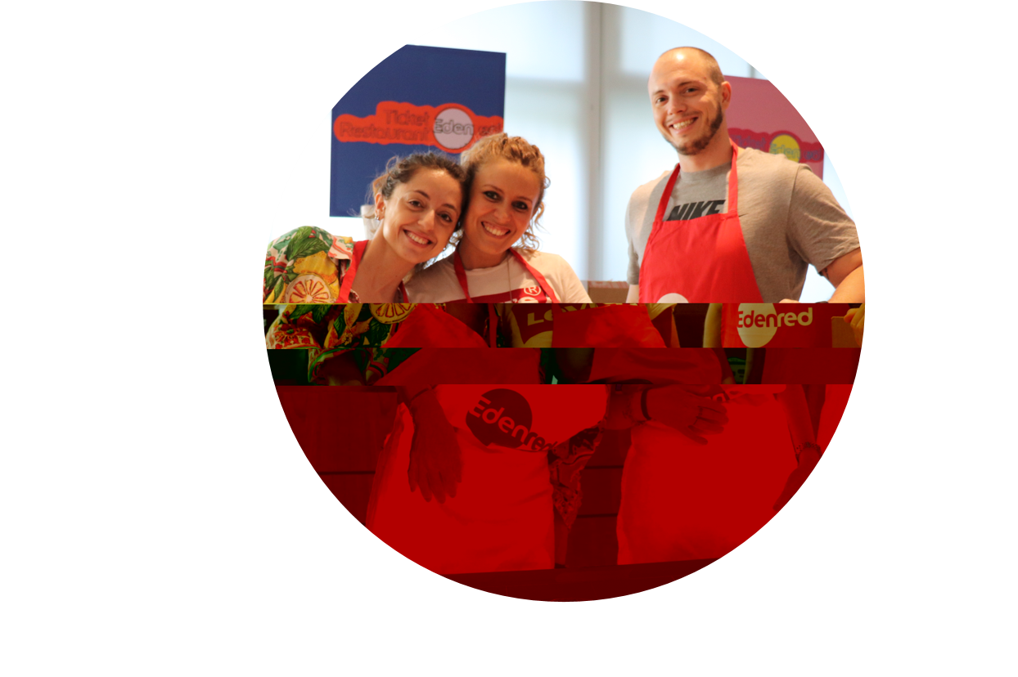
A csr approach around 3 pillars
IMPROVE QUALITY OF LIFE
PRESERVE THE ENVIRONMENT
CREATE VALUE RESPONSIBLY
Notes:
People - Edenred vise à être un employeur de référence en terme de développement professionnel, droits humain et diversité, à promouvoir les solutions de bien-être via l'alimentation saine, durable ainsi qu’à contribuer au développement local.
Planet – Edenred cherche à protéger l’environnement en réduisant son empreinte carbone, ses consommations ainsi que ses déchets, en concevant des éco-services pour la mobilité durable et contre le gaspillage, tout en pilotant l’impact de ses solutions.
Progress - Edenred s’engage à développer ses activités et partenariats de manière éthique sur toute sa chaîne de valeur. Le Groupe garantit la sécurité informatique et la protection des données en répondant aux attentes de ses clients et utilisateurs et en les associant à sa transformation digitale.

Slide 6
Sustainable Development Goals commitments
Edenred complies with the principles of the United Nations Global Compact and contributes to the Sustainable Development Goals (SDGs) set by the United Nations for 2030.
Edenred works toward 12 of the 17 SDGs.
In addressing global issues and meeting public policy objectives, Edenred’s solutions naturally contribute to the SDGs.
Talent management
Human rights
Well-being and engagement
Sustainable and healthy food promotion
Fight against food waste
Diversity
Social and economic contribution
Responsible payment digitalization
Fighting against climate change
Solution accessibility
Resources and waste management
IT security
Data protection
Business ethics
Eco-design and circular economy
Sustainable mobility promotion
Fighting against food waste
Notes:
Signataire du Pacte mondial des Nations Unies (Global Compact), le Groupe intègre également dans ses solutions les enjeux sociaux et environnementaux alignés aux Objectifs Mondiaux de Développement Durable (ODD) fixés par l’ONU à l’horizon 2030. De par ses engagements sociétaux, Edenred participe à l’avancement de 12 de ces objectifs, à travers les trois axes de sa politique RSE.

Slide 7
Cross-analysis: from issues to ambitions
Talent management
Diversity
Labor & human rights
Social & economic contribution
Energy & climate change
Sustainable mobility promotion
Fight against food waste
Eco-designing, circular economy
Resource & waste management
Business ethics
IT security & data privacy
Responsible payment digitalization
Client satisfaction
Sustainable and healthy food promotion
Accessibility to solutions

Slide 8
Our strategy targets
KEY INDICATORS | 2017 | 2022 | 2030 | Supported SDGs
TRAINING – % employees who received at least 1 learning/year and 100% employees receiving one CSR training by 2025 | 78% | 80% | 85%
DIVERSITY – % women among executive positions | 21% | 31% | 40%
SOLIDARITY – Number of days of volunteering | 586 days | 1,000 days | 5,000 days
GHG* EMISSIONS – % reduction intensity vs 2013 (GHG*/m²) | 18% | 34% ** | 52% **
SERVICES – Number of environmental-friendly services | 9 | 20 | 1/country
SOLUTIONS – % eco-designed / recycled solutions & 0 net paper for 2021 | 27% | 35% | 70%
ETHICS – % acknowledgment employees to Ethics Charter | 84% | 100% | WMEC***
DATA PROTECTION – % subsidiaries under common standard of compliance & employees sensitized on personal data issues |  | 100% Group subsidiaries | Binding Corporate Rules & Certifications
QUALITY – % coverage of quality management certified**** | 41% | 50% | 85%
SUSTAINABLE FOOD – % of food users & merchants sensitized to nutrition & food waste | 29% | 52% | 85%
*GHG = Greenhouse Gas. Total emission 2020 = 4,001 T
*** WMEC = World Most Ethical Companies
** Targets calculated using the Science Based Targets initiative methodology
**** Quality management certification such as ISO 9001

Slide 9
A global day of action to support communities
Every year, all Edenred countries gather their staff and stakeholders around volunteering initiatives related to its three CSR pillars:
Thanks to this event, Edenred forges strong ties with local communities and NGOs in order to assist people facing difficult circumstances.Save the date
25th June 2021
Idealday #6
June 21st, 2022
Around 100 partner associations
Around 3,000 employees volunteered
+1500 days of volunteering cumulated
PEOPLE
PLANET
PROGRESS
gender diversity workshops, meal distribution campaigns, support to shelters, renovations, donations of essentials…
waste consulting, beach and forest cleaning campaigns, tree planting…
mentoring with young entrepreneurs, digital inclusion for the elderly…

Slide 10
Next edition ➔ 14th September to 9th November 2022
An international solidarity sport-connected event for
Since 2017, Edenred organizes a yearly global sporting challenge in order to raise funds for an NGO:
Over the course of two months, employees from all Edenred countries can take part in this race by running, walking and cycling;
Every employee can participate thanks to their smartphone or any connected device (watch, strap…);
A competition between internal teams and Operating Companies;
In 2021, the objective is to reach a total distance of 1,000,000 km in order to raise €40,000 for MSF in their actions against Covid-19​.
Edenraid #5
Sept 14th – Nov 15th
A new record results:
1,111,857 km covered in over 46 countries
More than 3,600 participants
€40 000 raised

Slide 11
STRONG CSR network
>200 people involved in the CSR network globally!

Slide 12
Thank you!

